Slide 1
Intro to Infrastructure as Code
Introduction to Chef
Kansas LinuxFest– March 2015
https://github.com/micgo/kslf-2014

Slide 2
Michael Goetz
Solutions Engineering Manager at Chef
Co-organizer of Seattle Chef meetup
@michaelpgoetz
mpgoetz@chef.io

Slide 3
Hello!
System Administrator?

Slide 4
Hello!
System Administrator?
Developer?

Slide 5
Hello!
System Administrator?
Developer?
Ruby developer?

Slide 6
Hello!
System Administrator?
Developer?
Ruby developer?
DevOp?

Slide 7
Hello!
System Administrator?
Developer?
Ruby developer?
DevOp?
Business Person?

Slide 8
Are you experienced?
Experience with Infrastructure as Code or Configuration Management?

Slide 9
Are you experienced?
Experience with Infrastructure as Code or Configuration Management?
Experience with Chef?

Slide 10
Which version control system do you use?

Slide 11
Which version control system do you use?
cp foo foo.bak

Slide 12
Which version control system do you use?
cp foo foo.bak
cp foo{,.`date +%Y%m%d%H%M`}

Slide 13
Which version control system do you use?
cp foo foo.bak
cp foo{,.`date +%Y%m%d%H%M`}
cp foo{,.`date +%Y%m%d%H%M`-`$USER`}

Slide 14
Infrastructure as Code

Slide 15
The Sys Admin’s Journey
ssh

Slide 16
The Sys Admin’s Journey
ssh
Store notes in ~/server.txt

Slide 17
The Sys Admin’s Journey
ssh
Store notes in ~/server.txt
Move notes to the wiki

Slide 18
The Sys Admin’s Journey
ssh
Store notes in ~/server.txt
Move notes to the wiki
Write some scripts (setup.sh, fixit.sh, etc.)

Slide 19
The Sys Admin’s Journey
ssh
Store notes in ~/server.txt
Move notes to the wiki
Write some scripts (setup.sh, fixit.sh, etc.)
Golden images and snapshots

Slide 20
The Sys Admin’s Journey
ssh
Store notes in ~/server.txt
Move notes to the wiki
Write some scripts (setup.sh, fixit.sh, etc.)
Golden images and snapshots
Policy-driven configuration management

Slide 21
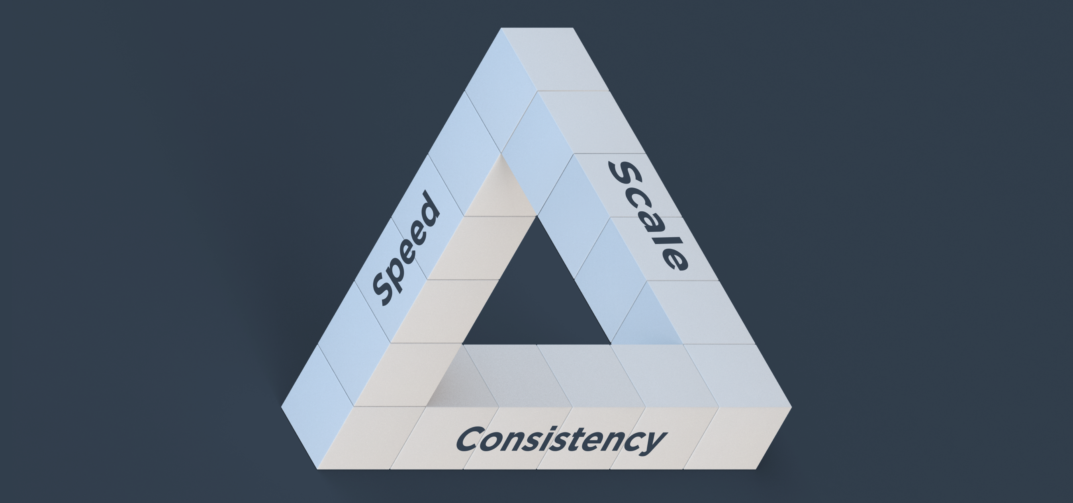
Benefits of Automation

Slide 22
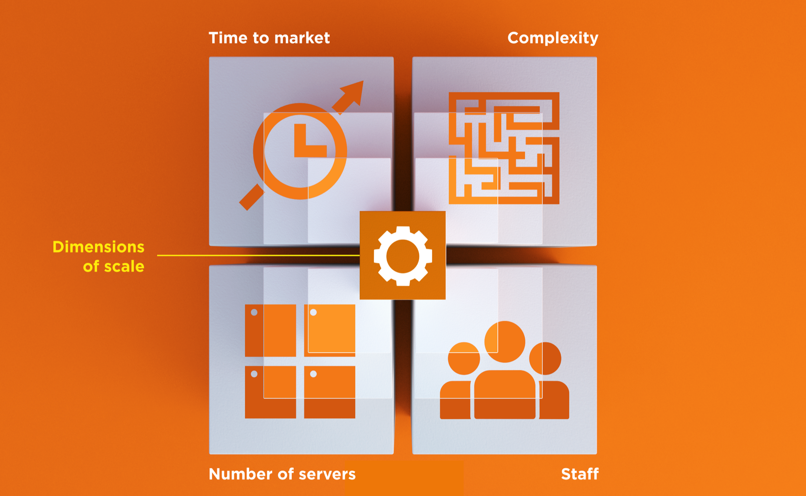
Dimensions of Scale

Slide 23
Automation Platform
Creates a dependable view of your entire network’s state.
Can handle complex dependencies among the nodes of your network.
Is fault tolerant.
Is secure.
Can handle multiple platforms
Can manage cloud resources
Provides a foundation for innovation

Slide 24
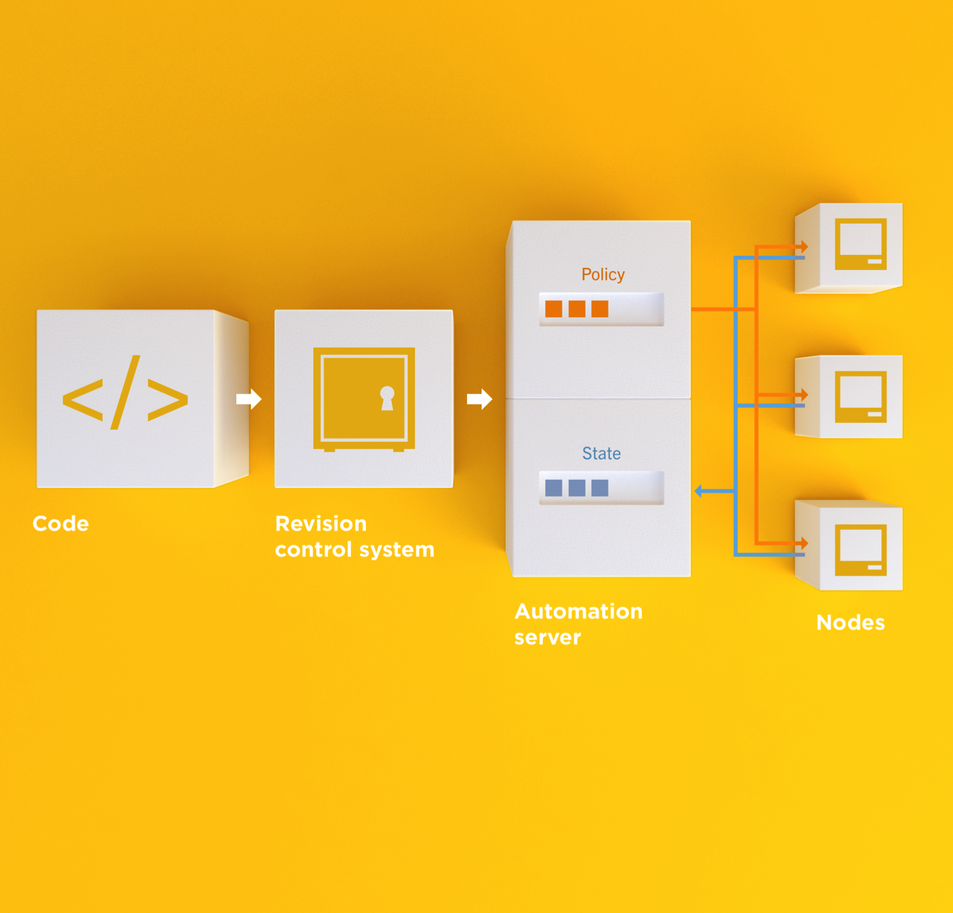
Infrastructure as Code
Programmatically provision and configure components
Notes:
Use the Chef framework and Chef programming language to define the components of your infrastructure. This allows you to capture and document the shape of your infrastructure in a consistent way.

Slide 25
Infrastructure as Code
Treat like any other code base
Notes:
Treat this like any other code base:
Store the code in a version control system.
Add automated tests to the code.
Refactor the code over time.
Build and version software artifacts (e.g. packages)
The code is executable documentation.
Store the code in a version control system.

Slide 26
Infrastructure as Code
Reconstruct business from code repository, data backup, and compute resources
Notes:
With your infrastructure now fully captured in code, you are now able to rebuild your entire business, well, at least all of your business’s applications, with your code repository, a backup of your data, and compute resources, be they bare metal, virtual machines, or cloud instances.

Slide 27
Infrastructure as Code
Programmatically provision and configure components
Treat like any other code base
Reconstruct business from code repository, data backup, and compute resources
Notes:
Stop for a minute and think about what we're saying here. Think about how freeing this can be. The next configuration change you need to make in production starts with a commit to your version control system. You can re-provision your infrastructure with another service provider; move from the data center to the clould and back again.How will this impact the way you run operations in your organization?What questions do you have?

Slide 28
Policy-based
You capture the policy for your infrastructure in code
A program ensures each node in your infrastructure complies with the policy
A control loop keeps the system stable and allows for change when policy is updated

Slide 29
Sample Infrastructure
Graphite
Nagios
JBoss
Memcache
Postgres Slaves
Postgres Master

Slide 30
New Compliance Mandate!
Graphite
Nagios
JBoss
Memcache
Postgres Slaves
Postgres Master

Slide 31
New Compliance Mandate!
Graphite
Nagios
JBoss
Move SSH off of port 22
Let’s put it on 2022
Memcache
Postgres Slaves
Postgres Master

Slide 32
6 Golden Images to Update
Graphite
1
1
Nagios
1
1
1
1
1
JBoss
1
1
Memcache
1
1
Postgres Slaves
1
Postgres Master

Slide 33
6 Golden Images to Update
Graphite
1
2
Nagios
3
JBoss
/etc/ssh/sshd_config
--- a/sshd_config
+++ b/sshd_config
-Port 22
+Port 2202
4
Memcache
5
Postgres Slaves
6
Postgres Master

Slide 34
12 Instances to replace
Graphite
1
2
Nagios
3
4
5
6
7
JBoss
Launch
Delete
Repeat
Typically manually
8
9
Memcache
10
11
Postgres Slaves
12
Postgres Master

Slide 35
Done in maintenance window
Graphite
1
2
Nagios
3
4
5
6
7
JBoss
High stakes
Late hours
Risky change
8
9
Memcache
10
11
Postgres Slaves
12
Postgres Master

Slide 36
New configurations required?
Graphite
Nagios
JBoss
Do the new instances have new IP Addresses?
* Not all connections shown
Memcache
Postgres Slaves
Postgres Master

Slide 37
Golden Images vs. Policy-based

Slide 38
Chef
Fast, scalable, flexible IT automation

Slide 39
What is Chef
Open source framework for managing complexity in your infrastructure through policy-driven automation code
A community of professionals
A company
Notes:
~60K professionals

Slide 40
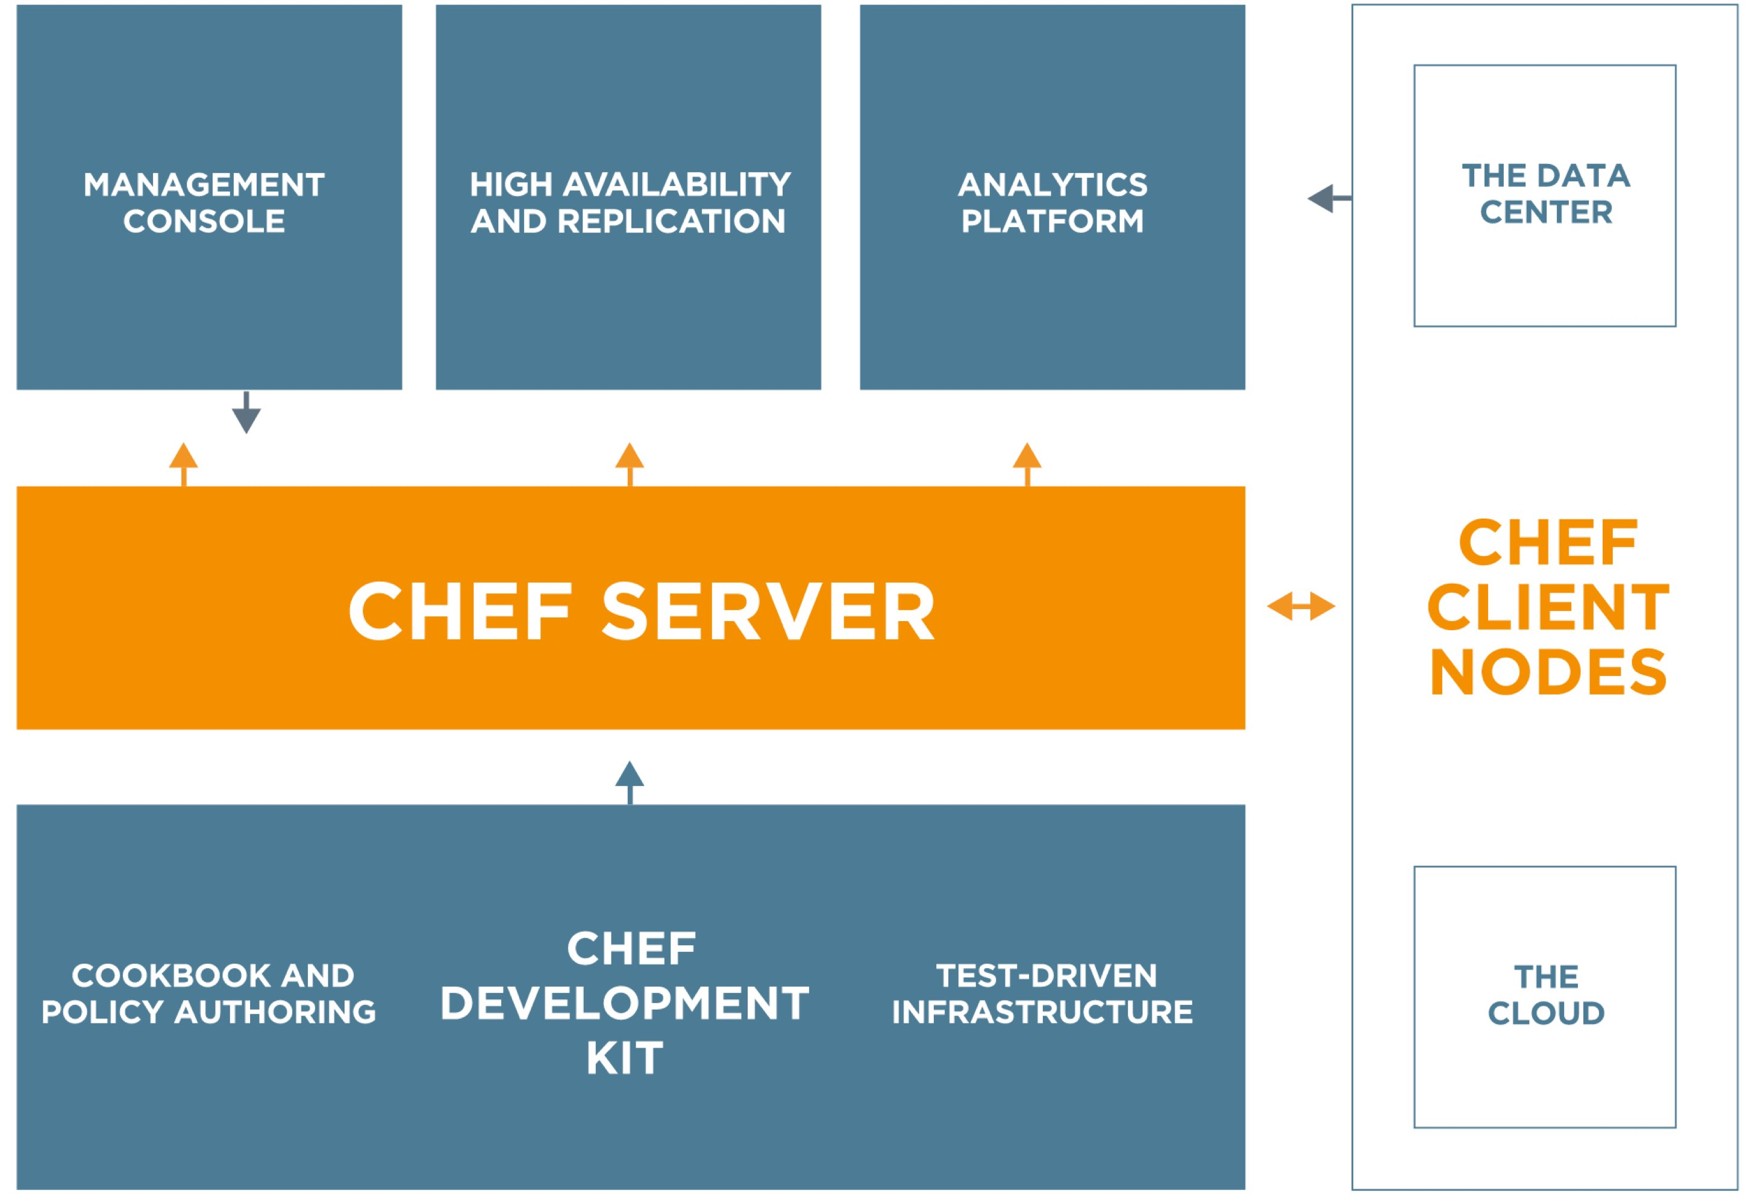
Chef
https://www.chef.io/chef/
Notes:
All Open Source!

Slide 41
Chef Server – Policy & State
Notes:
Policy –

Slide 42
Desired Configuration

Slide 43
Desired Configuration

Slide 44
Desired Configuration

Slide 45
Chef Server – Policy & State
Notes:
Policy –

Slide 46
HA Proxy Configuration

Slide 47
HA Proxy Configuration

Slide 48
HA Proxy Configuration

Slide 49
HA Proxy Configuration

Slide 50
HA Proxy Configuration

Slide 51
HA Proxy Configuration

Slide 52
HA Proxy Configuration

Slide 53
HA Proxy Configuration

Slide 54
HA Proxy Configuration

Slide 55
Building your policy
Resources and Recipes
Notes:
Policy is defined as a collection of resources in recipes. There are lots of abstractions on top of this but resources are the basic building blocks.

Slide 56
Resources
Piece of the system and its desired state
Package that should be installed
Service that should be running
File that should be generated
Cron job that should be configured
User that should be managed
And more
docs.chef.io/chef/resources.html

Slide 57
Hello, Chef!
~/hello_chef.rb
file "/tmp/hello_chef.txt" do
content "Hello, Chef"
mode "0777"
end

Slide 58
Apply the policy
sudo chef-apply hello_chef.rb
Recipe: (chef-apply cookbook)::(chef-apply recipe)
* file[/tmp/hello_chef.txt] action create
- create new file /tmp/hello_chef.txt
- update content in file /tmp/hello_chef.txt from none to 79c290
--- /tmp/hello_chef.txt 2014-10-22 19:59:04.000000000 -0400
+++ /tmp/.hello_chef.txt20141022-23075-19aelx1 2014-10-22 19:59:04.000000000 -0400
@@ -1 +1,2 @@
+Hello, Chef
- change mode from '' to '0777'

Slide 59
Resources
Describe the desired state
Do not need to tell Chef how to get there
What happens when you re-apply the policy?

Slide 60
Apply the policy
sudo chef-apply hello_chef.rb
Recipe: (chef-apply cookbook)::(chef-apply recipe)
* file[/tmp/hello_chef.txt] action create (up to date)

Slide 61
Resources
A piece of the system
Its desired state
file "/tmp/hello_chef.txt" do
content "Hello, Chef"
mode "0777"
end

Slide 62
Change the state of the system
echo “Hello, #kansaslinuxfest” > /tmp/hello_chef.txt

Slide 63
Apply the policy
sudo chef-apply hello_chef.rb
Recipe: (chef-apply cookbook)::(chef-apply recipe)
* file[/tmp/hello_chef.txt] action create
- update content in file /tmp/hello_chef.txt from e453df to 79c290
--- /tmp/hello_chef.txt 2014-10-22 20:00:20.000000000 -0400
+++ /tmp/.hello_chef.txt20141022-23340-17a7m5t 2014-10-22 20:00:50.000000000 -0400
@@ -1,2 +1,2 @@
-“Hello, #kansaslinuxfest”
+Hello, Chef

Slide 64
Resources – Test and Repair
Resources use a test and repair model
Resource currently in the desired state?
Yes – Do nothing
No – Bring the resource into the desired state (repair)

Slide 65
Built-in Resources
package
template
service
cron
directory
mount
user
group
registry_key
remote_directory
route
and many more…
docs.chef.io/chef/resources.html

Slide 66
Recipes
Policy is defined as a collection of resources in recipes. There are lots of abstractions on top of this but resources are the basic building blocks.

Slide 67
Sample Recipe
package "httpd"
template "/etc/httpd/conf/httpd.conf" do
source "httpd.conf.erb"
owner "root"
group "root"
mode "0644"
notifies :restart, "service[httpd]"
end
service "httpd" do
action [:start, :enable]
end
file "/var/www/html/index.html" do
content "Hello, Kansas Linuxfest!"
end

Slide 68
Test-driven Infrastructure
Change policy with confidence

Slide 69
New policy mandate
Apache should listen on port 81, not the default port!
Verify policy changes BEFORE applying the changes to production

Slide 70
Questions to ask when testing
Did chef-client complete successfully?
Did the recipe put the node in the desired state?
Are the resources properly defined?
Does the code following our style guide?

Slide 71
Chef client success status
Requirements to verify chef-client success:
A place to store the cookbook artifact

Slide 72
Chef client success status
Requirements to verify chef-client success:
A place to store the cookbook artifact
A chef-client with access to the cookbook

Slide 73
Chef client success status
Requirements to verify chef-client success:
A place to store the cookbook artifact
A chef-client with access to the cookbook
A target server running the same OS as production

Slide 74

Test Kitchen
Test harness to execute code on one or more platforms
Driver plugins to allow your code to run on various cloud and virtualization providers
Includes support for many testing frameworks
Included with ChefDK

Slide 75
Test Kitchen Lifecycle
kitchen create
kitchen list
kitchen converge
kitchen login
kitchen destroy

Slide 76
Questions to ask when testing
Did chef-client complete successfully?
Did the recipe put the node in the desired state?
Are the resources properly defined?
Does the code following our style guide?

Slide 77
Manually Inspect with kitchen login
kitchen login
kitchen@localhost's password:

Slide 78
Manually Inspect with kitchen login
kitchen login
kitchen@localhost's password:
kitchen

Slide 79
Manually Inspect with kitchen login
kitchen login
kitchen@localhost's password:
Last login: Wed Sep 24 04:30:29 2014 from 172.17.42.1
kitchen

Slide 80
Manually Inspect with kitchen login
curl http://localhost
Hello, Kansas LinuxFest!

Slide 81

Serverspec
Write RSpec tests to verify your servers
Not dependent on Chef
Defines many resource types
package, service, user, etc.
Works well with Test Kitchen
http://serverspec.org/

Slide 82
Serverspec Test
test/integration/default/serverspec/default_spec.rb
require 'serverspec'
set :backend, :exec
describe "apahce" do
it "has httpd package installed" do
expect(package('httpd')).to be_installed
end
it "is listening on port 80" do
expect(port(80)).to be_listening
end
it "displays our home page" do
expect(command("curl http://localhost").stdout).to match /Kansas LinuxFest/
end
end

Slide 83
Verify the kitchen
kitchen verify
-----> Setting up Busser
Creating BUSSER_ROOT in /tmp/busser
Creating busser binstub
Plugin serverspec installed (version 0.2.6)
-----> Running postinstall for serverspec plugin
Finished setting up <default-centos-64> (0m32.59s).
-----> Verifying <default-centos-64>...
Suite path directory /tmp/busser/suites does not exist, skipping.
Uploading /tmp/busser/suites/serverspec/default_spec.rb (mode=0664)
-----> Running serverspec test suite
/opt/chef/embedded/bin/ruby -I/tmp/busser/suites/serverspec -S /opt/chef/embedded/bin/rspec /tmp/busser/suites/serverspec/default_spec.rb --color --format documentation
apache
is installed
Finished in 0.29547 seconds
1 example, 0 failures
Finished verifying <default-centos-64> (0m4.44s).
-----> Kitchen is finished. (1m25.74s)

Slide 84
Questions to ask when testing
Did chef-client complete successfully?
Did the recipe put the node in the desired state?
Are the resources properly defined?
Does the code following our style guide?

Slide 85
Now for our new mandate
Update the tests
Watch them fail
Update the policy
See tests pass
Roll-out changes to production

Slide 86
Wrapping Up

Slide 87
We’ve only scratched the surface
https://www.chef.io/chef/
Notes:
All Open Source!

Slide 88
Build Anything
Simple internal applications
Complex external applications
Workstations
Hadoop clusters
IaaS infrastructure
PaaS infrastructure
SaaS applications
Storage systems
You name it
http://www.flickr.com/photos/hyku/245010680/

Slide 89
And Manage it Simply
Automatically reconfigure everything
Linux, Windows, Unixes, BSDs
Load balancers
Metrics collection systems
Monitoring systems
Cloud migrations become trivial
http://www.flickr.com/photos/helico/404640681/

Slide 90
What questions do you have?
Ask me anything!
@michaelpgoetz
mpgoetz@chef.io
Thank you!

